Slide 1
Chapter 9:
DNA determines the structure and function of cells

Slide 2
9.1 DNA, genes and chromosomes
DNA
DNA, or deoxyribonucleic acid, is a molecule found in the cells of all organisms – bacteria, single-celled plants and animals, and all complex plants and animals, including humans.
It contains the genetic information that determines the structure of the cell and the way it functions.
Most of the DNA molecules are found in the nucleus of each cell, and are therefore called nuclear DNA. There is also a small amount of DNA found in the mitochondria. This DNA is called mitochondrial DNA, or mtDNA. While mtDNA makes up less than 1% of the total DNA in humans, it is important for the functioning of the mitochondria and, therefore, the cell.

Slide 3
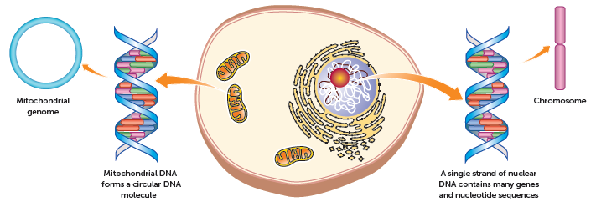
9.1 DNA, genes and chromosomes

Slide 4
9.1 DNA, genes and chromosomes
Structure of DNA
DNA is one of the two main types of nucleic acids found in the body; the other is RNA, or ribonucleic acid.
DNA is an example of a polymer, a molecule made up of many repeating small units. The small repeating units are nucleotides.
Each nucleotide is composed of a sugar molecule (deoxyribose in DNA), a phosphate group and a nitrogenous base. There are four different nitrogen bases in the DNA molecule: adenine (A), thymine (T), cytosine (C) and guanine (G).
The sugar molecule of one nucleotide bonds to the phosphate group of another one. This forms a long chain of alternating sugars and phosphates, with side chains of bases. In DNA, two strands join by specific bases being attracted to one another by weak hydrogen bonds. Cytosine on one strand can only bond to guanine on the other strand, while adenine can only bond to thymine. The two strands of DNA twist into a spiral shape called a double helix.

Slide 5
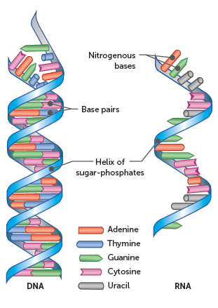
9.1 DNA, genes and chromosomes
The order in which the nitrogenous bases occur in the DNA molecule determines the genetic code. Molecules of DNA are in the form of long strands – between 2 and 3 metres in a human cell.

Slide 6
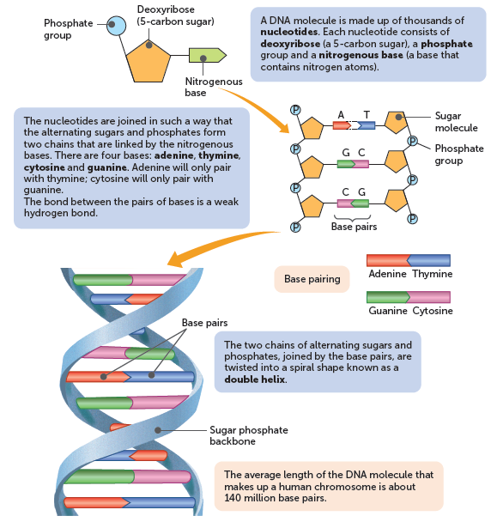
9.1 DNA, genes and chromosomes

Slide 7
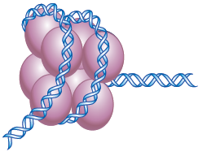
9.1 DNA, genes and chromosomes
Structure of chromosomes
DNA strands are wrapped around a group of eight special proteins called histones to form a nucleosome. There are many nucleosomes along the length of a DNA molecule.
In a cell that is not dividing, the coiled DNA forms a tangled network called chromatin. However, when a cell divides the coiled chromatin becomes more tightly coiled, forming structures called chromosomes.
There are 46 chromosomes in a normal human cell. Each chromosome is made up of sections of DNA that code for a particular protein. Each of these sections is called a gene.

Slide 8
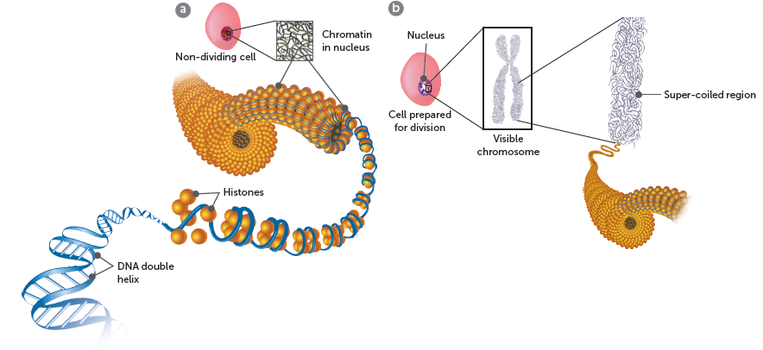
9.1 DNA, genes and chromosomes
a When a cell is not dividing, the DNA is wrapped around histones in a tangled network called chromatin
b When a cell is dividing, the chromatin becomes super-coiled to form chromosomes

Slide 9
9.1 DNA, genes and chromosomes
Mitochondrial DNA
Most of a cell’s DNA is located in the nucleus, but a small amount is in the mitochondria. This is called mitochondrial DNA, or mtDNA.
There are two important differences between DNA in the nucleus and mtDNA.
Nuclear DNA is in the form of very long strands that are bound to proteins, the histones.
Mitochondrial DNA is in the form of small circular molecules that are not bound to proteins.

Slide 10
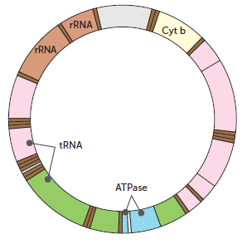
9.1 DNA, genes and chromosomes
There are about 5-10 molecules of mtDNA in each mitochondrion. It has 37 genes, all of which are essential for the mitochondrion to function normally. Twenty-four of the genes contain the code for making transfer RNA (tRNA) molecules, which are involved in protein synthesis. The other 13 genes have instructions for making some of the enzymes necessary for the reactions of cellular respiration.
Model of a molecule of mtDNA showing the location of some of the genes

Slide 11
9.1 DNA, genes and chromosomes
Replication of DNA
Cells divide through the processes of mitosis and meiosis. In all cell divisions, the DNA must produce an exact copy of itself. This is known as DNA replication.
The first stage of DNA replication is when the two strands of the DNA molecule are separated by the enzyme helicase.
Each strand of the separated section contains half the original information. Each strand serves as a template for the nucleotides that will form the new strand. As the base adenine can only pair with thymine, and cytosine can only pair with guanine, the new strand that forms is identical to the original.
Two enzymes play important roles in the synthesis of the new strands. DNA polymerase adds the new nucleotides to the new strand, and DNA ligase joins short sections of DNA together.

Slide 12
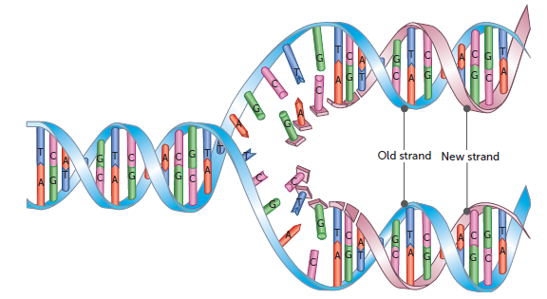
9.1 DNA, genes and chromosomes
DNA replication – the two strands separate and act as templates for new strands

Slide 13
9.2 Protein synthesis
Protein synthesis
The genetic code in DNA provides the instructions for protein synthesis – making proteins in the cell. Proteins are produced from amino acids being joined together by peptide bonds. The sequence of bases in DNA controls the order of amino acids, and therefore the type of protein that is produced.
Some proteins you have heard of include:
Haemoglobin
Acting and myosin
Albumin
Fibrin
Collagen
Insulin
Immunoglobins

Slide 14
9.2 Protein synthesis
Ribonucleic acid
Ribonucleic acid (RNA) is another type of nucleic acid. Like DNA, RNA is composed of a chain of nucleotides. While there are many similarities between DNA and RNA, there are also some key differences.
The sugar molecule is ribose, not deoxyribose. Ribose has one more oxygen atom than deoxyribose.
RNA is single stranded, while DNA is double stranded.
RNA has the bases cytosine, guanine, adenine and uracil, while DNA has the bases cytosine, guanine, adenine and thymine. The structures of thymine and uracil are very similar. This means that uracil is also complementary to adenine.
The RNA strand is able to fold on to itself, forming hydrogen bonds between complementary bases.

Slide 15
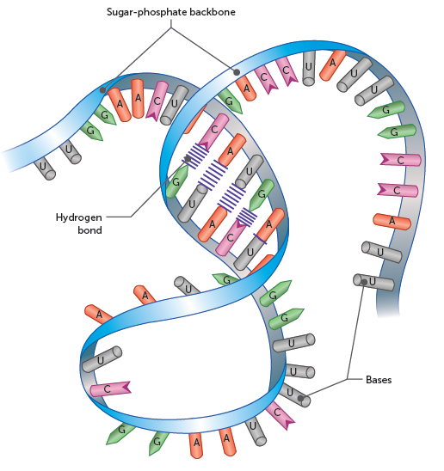
9.1 DNA, genes and chromosomes

Slide 16
9.2 Protein synthesis
Types of RNA
There are four types of RNA, each with its own role in protein synthesis.
Messenger RNA (mRNA) is made in the nucleus and takes the genetic code into the cytoplasm
Ribosomal RNA (rRNA) makes up approximately 60% of the mass of ribosomes, with the other 40% being protein. The rRNA ensures the correct alignment of mRNA, tRNA and ribosome. It also has an enzymatic role in the formation of peptide bonds between amino acids.
Transfer RNA (tRNA) is a small molecule of RNA, containing only 70–90 nucleotides. Each tRNA molecule is able to carry a specific amino acid and therefore plays a vital role in protein synthesis.

Slide 17
9.2 Protein synthesis
From DNA to proteins
DNA contains the genetic code, the sequences of bases determining the proteins that are produced. A sequence of three bases is the code for a particular amino acid and is called a triplet (or a base triplet).
While most DNA is found in the nucleus and is too large to leave, proteins are produced by ribosomes in the cytosol. This means that there must be processes to transfer the genetic code from the nucleus to the cytosol.

Slide 18
9.2 Protein synthesis
Transcription
Transcription is the process by which the genetic instructions are copied (or transcribed) from the DNA to the mRNA molecule. The transcription is triggered by chemical messengers that enter the nucleus from the cytosol and bind to the DNA at the relevant gene. This causes an enzyme called RNA polymerase to begin the process of making mRNA.
First, the helicase enzyme makes the double-stranded DNA molecule come apart. It usually separates about 17 base pairs at a time. RNA polymerase then transcribes (copies) the bases on one strand of the DNA to make a complementary molecule of mRNA.
The following diagram shows the process of mRNA formation. At the end of the gene, a sequence of bases tells the RNA polymerase to stop copying, and as a result the mRNA molecule is released. Often other RNA polymerases will follow the first one, so that many copies of the same mRNA are made.

Slide 19
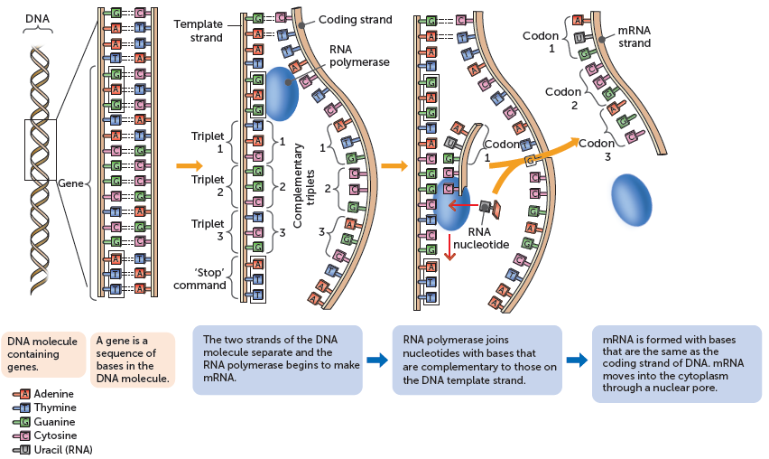
9.2 Protein synthesis
Only one of the strands of the DNA molecule is copied during transcription. This is called the template strand because it is the template from which the mRNA is made. The other DNA strand is known as the coding strand.

Slide 20
9.2 Protein synthesis
Translation
Translation is the production of a protein using the information that is coded in the mRNA molecule. In the cytosol, a ribosome attaches to one end of the mRNA molecule at a particular sequence of bases (adenine, uracil, guanine) called the start codon. This ensures that the ribosome attaches to the correct end of the mRNA.
The ribosome then moves along the mRNA three bases at a time. Each group of three bases is called a codon and corresponds to a specific amino acid.
As the ribosome reads the codons on the mRNA, the tRNA molecules with the complementary bases join to the mRNA. The sequence of three bases matching the codon is called the anticodon.

Slide 21
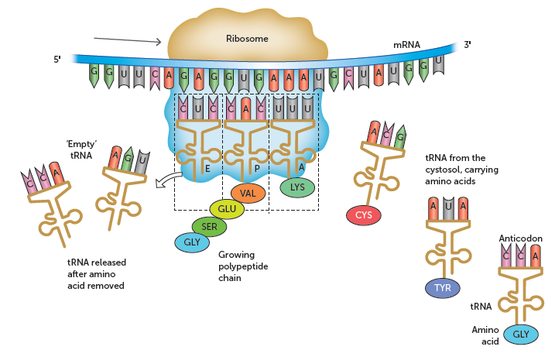
9.2 Protein synthesis
The amino acids carried by the tRNA are joined so that the protein is assembled with the amino acids in the correct sequence. For each bond formed between the amino acids, the energy from the breakdown of one ATP molecule is required. Once the tRNA has delivered its amino acid, it detaches from the ribosome and can then pick up another amino acid from the cytosol.

Slide 22
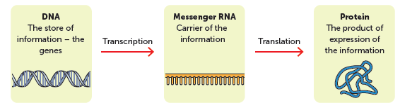
9.2 Protein synthesis
Gene expression
The process of copying information from DNA on to messenger RNA (mRNA) and then translating the message into a series of amino acids to form a protein is called gene expression.
Only certain genes are transcribed in each cell. Genes are switched on or off in accordance with the type of cell and its activity.

Slide 23
9.2 Protein synthesis
Lipid and carbohydrate synthesis
There are no genes that carry instructions for the manufacture of lipids or carbohydrates. However, the synthesis of these substances requires enzymes, and enzymes are proteins. The DNA in the genes carries the code for protein manufacture, therefore the genes indirectly control the synthesis of lipids and carbohydrates.

Slide 24
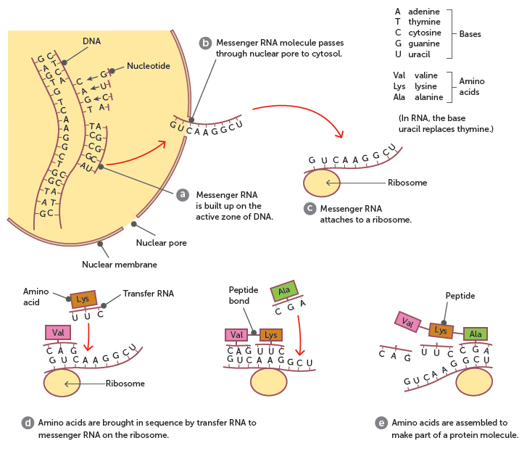
9.2 Protein synthesis
Synthesis of proteins from the DNA code

Slide 25
9.3 Epigenetics
Epigenetics
‘Epigenetics’ refers to changes in gene expression that result from mechanisms other than changes in the genes – that is, in the DNA or genome. Epigenetics is an important area of research where scientists try to find out the factors that help to make us who we are and influence what diseases we might acquire.
A person’s genome is the hereditary information that is encoded in their DNA. Their epigenome is the sum of all the factors that determine when, where and which genes are ‘switched on’ or expressed. The epigenome helps to control which genes are active in a particular cell and therefore which proteins will be produced.
One way in which genes are regulated epigenetically is through changes in chromatin.

Slide 26
9.3 Epigenetics
Chromatin
Gene expression may change if the way in which the DNA is wrapped around the histone changes. There are a number of ways a change in the structure of the chromatin can occur.
If some of the amino acids that are in the histone proteins are changed, this will change the shape of the histone.
Acetylation – the addition of an acetyl group to the histone protein. Acetylation relaxes the chromatin and increases transcription, enhancing gene expression.
Methylation – the addition of methyl groups to the DNA molecule or histone proteins. Histone methylation may either increase or decrease the transcription of genes, depending on where the methyl groups attach and how many become attached.

Slide 27
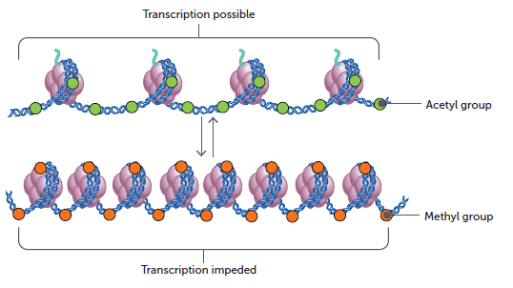
9.3 Epigenetics
Acetylation relaxes the chromatin and increases transcription, whereas methylation tightens the chromatin, which decreases transcription

Slide 28
9.3 Epigenetics
Environment and the epigenome
A person’s epigenome can be changed by exposure to certain environmental stimuli. Examples of environmental agents that may cause epigenetic changes are severe stress, nutritional factors, and toxins or drugs that may enter cells.
Such agents do not change the DNA, but they interfere with the transcription and translation processes involved in protein production.

